Slide 1
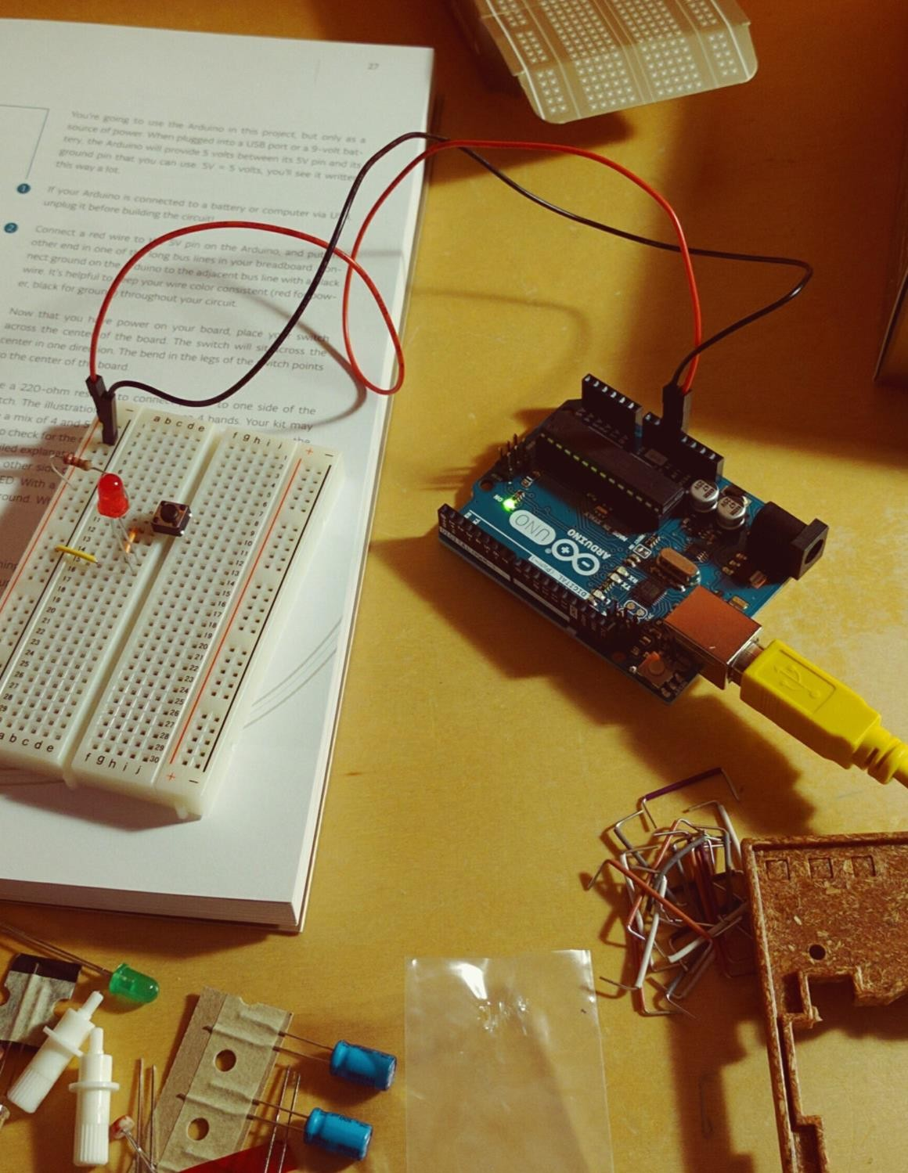
UDL MINF 2020 - 21
Ubiquitous
& Embedded Systems
4th Sprint
Chemical Plant project
Team 1 Danillo Lange, Jeongyun Lee, Ronnel Mathew
Github : https://github.com/jy-977/UBQ- Danillo Lange : https://github.com/roxdan Jeongyun Lee : https://github.com/jy-977 Ronnel Mathew : https://github.com/ron7858

Slide 2
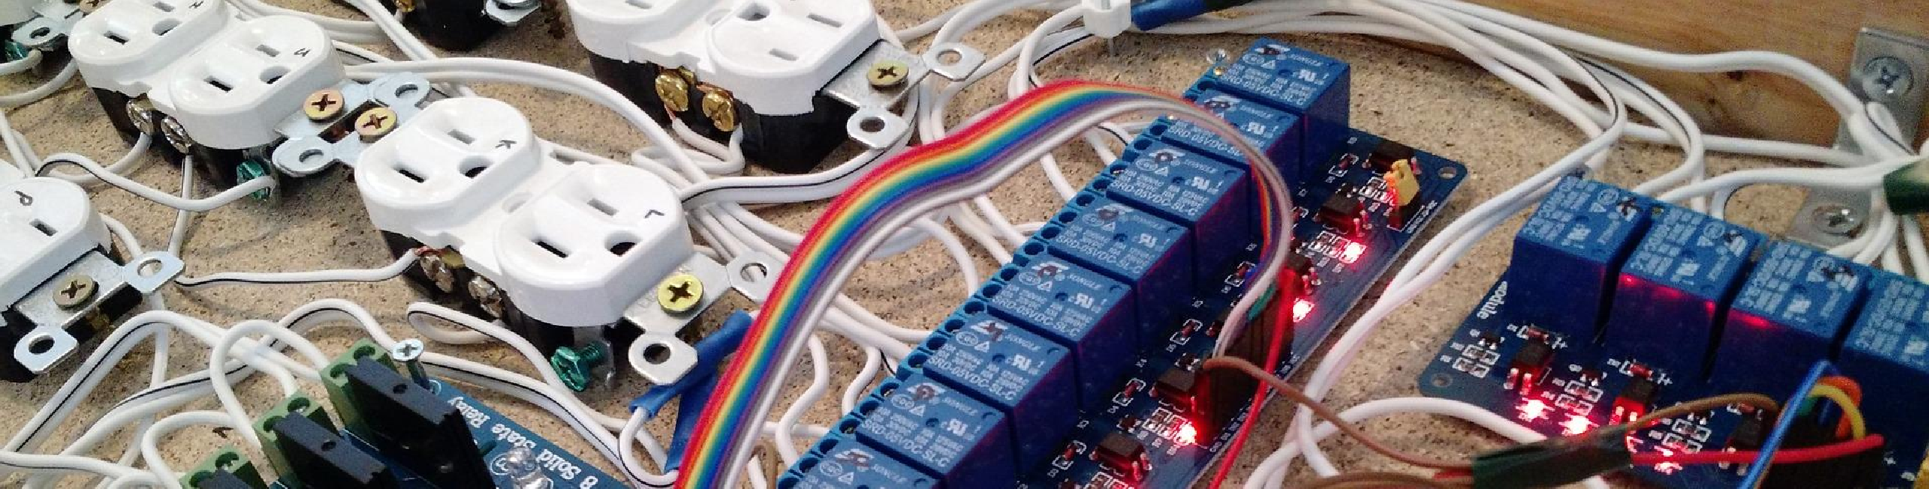
4th Sprint
Chemical Plant project

Slide 3

04
CO NEW VISION 2020
Follow up on 3rd Sprint
→ How to -> LCD Screen: Raspberry + LCD
→ R.Pi <-> Arduino interaction: Raspberry + Arduino + i2c protocol
→ How to -> I2C protocol: i2c protocol behavior and connections
→ How to -> PCF 8754: PCF connections with LED's + ChibiOS Code

Slide 4
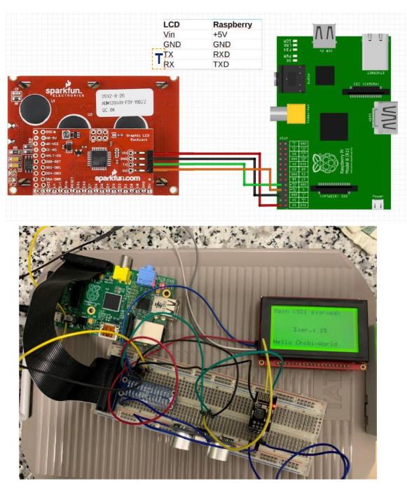
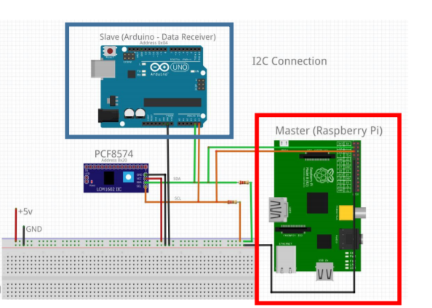
Follow Up
Raspberry + Arduino interaction
Raspberry + LCD screen

Slide 5
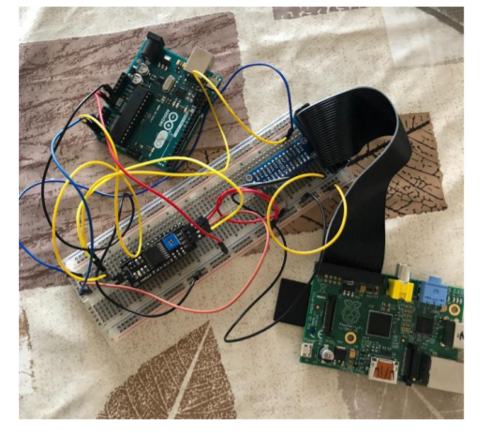
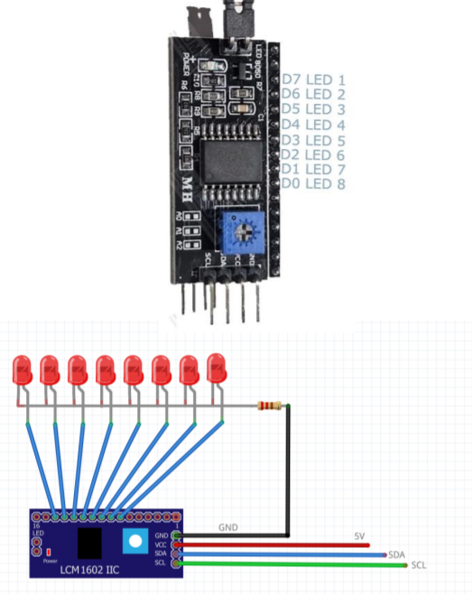
Follow Up
I2C Protocol
PCF8574 connection

Slide 6


SCRUM SPRINT
3 Yoon
5 D / R
2 Ron
8 Group
Final Assembly

Slide 7
04
CO NEW VISION 2020
4th Sprint
Sprint tasks:
Temperature/Humidity <-> Screen representation - Effort: 3 - (Yoon)
Ultrasonic <-> Led bar representation - Effort: 5 - (Danillo)
Final Assembling – Effort 8 - (Group)

Slide 8
4th Sprint Details
01. User Stories
Operator requires information of the temperature and humidity
Requirement to make a graphical representation of the obtained temperature and humidity on the LCD screen.
Operator requires information of the current tank container level in real time and it must be shown in a led bar present in the controller
Requirement to work with the PCF 8754 to turn on LEDs on an LED bar to represent the level of the tank.
→ Data log and Screen representation
→ Ultrasonic <-> LED bar representation

Slide 9
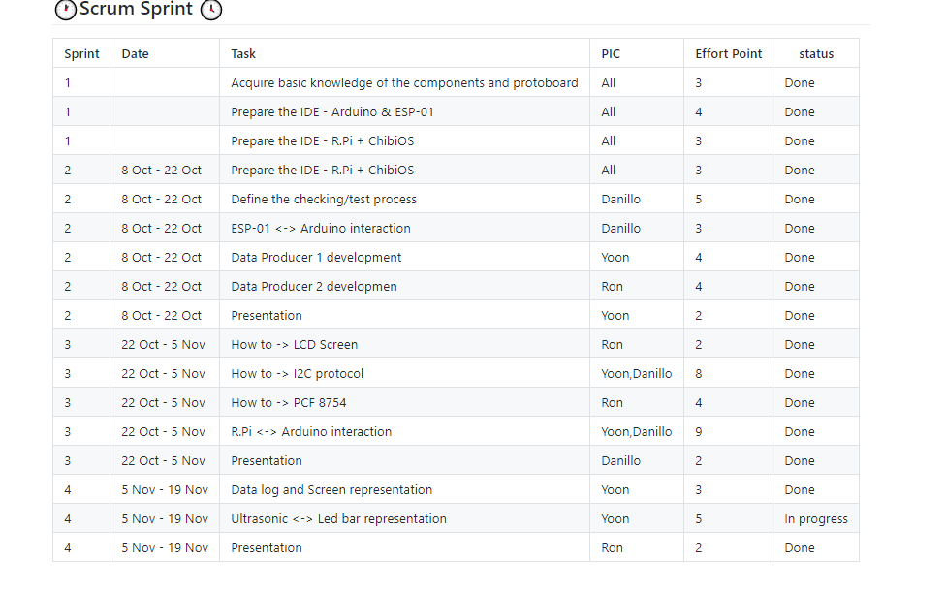
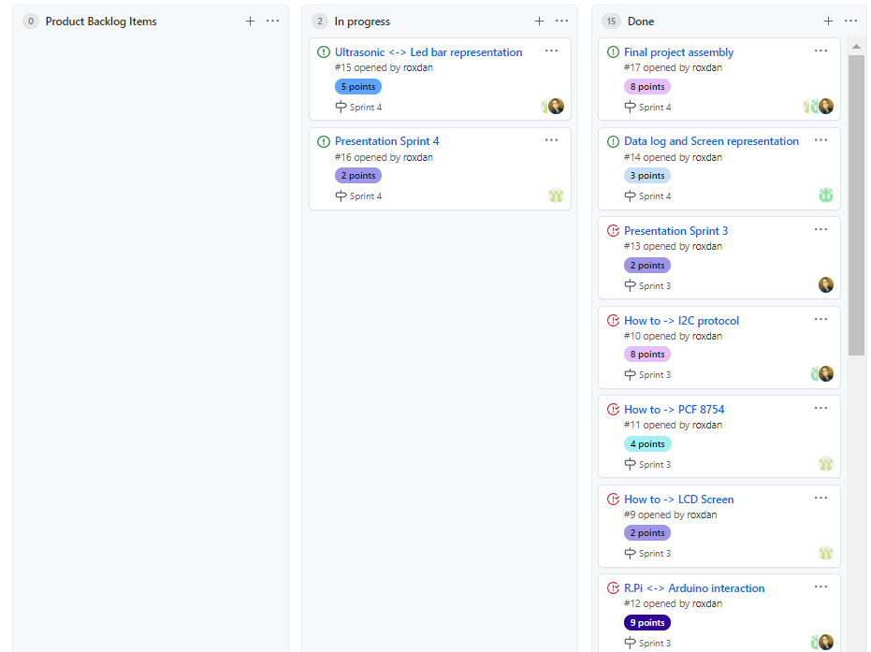
04
CO NEW VISION 2020
4th Sprint Scrum managing

Slide 10
04
Briefing Tasks 4th Sprint
Danillo Lange
Jeongyun Lee
Ronnel Mathew

Slide 11
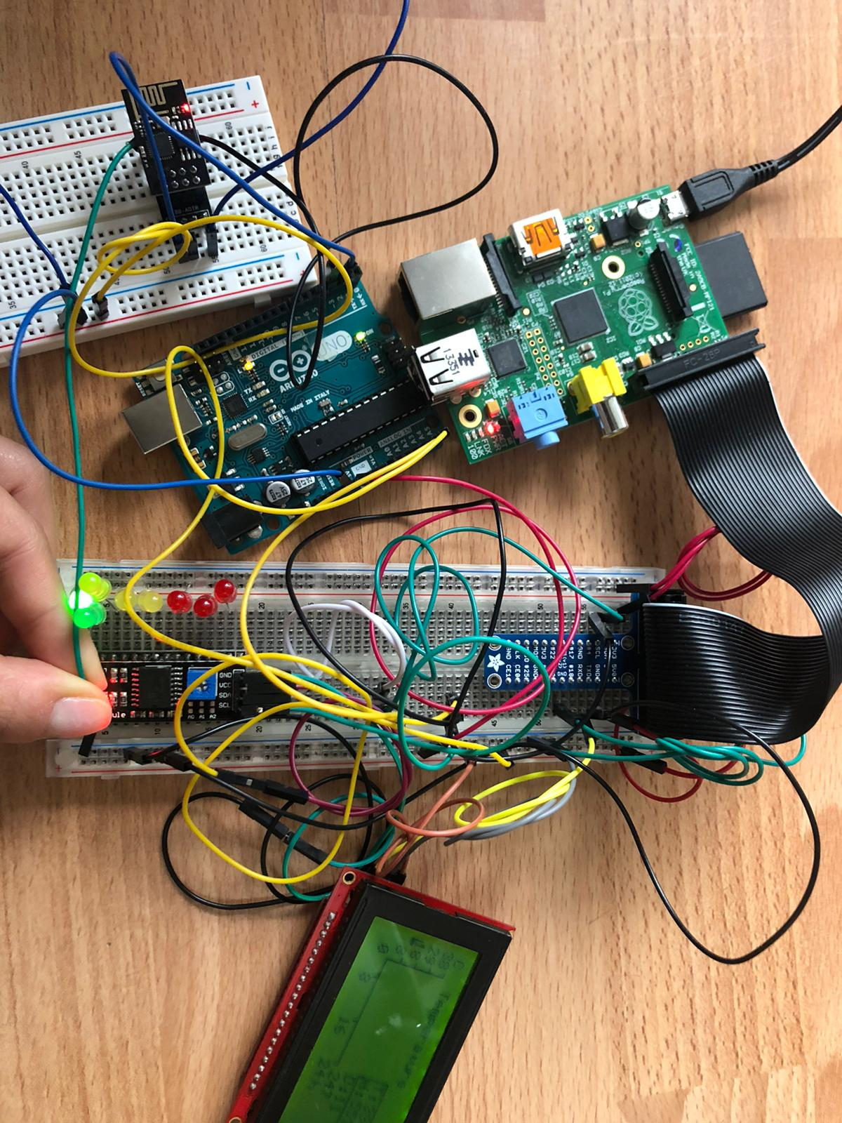
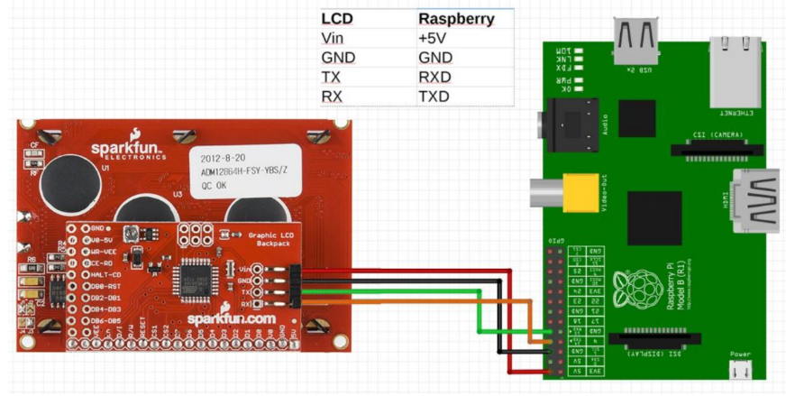
Jeongyun Lee
Briefing the ongoing tasks
Datalog and Screen representation
The code is present in the GitHub repo and here the wiring connection can be seen as follows:

Slide 12
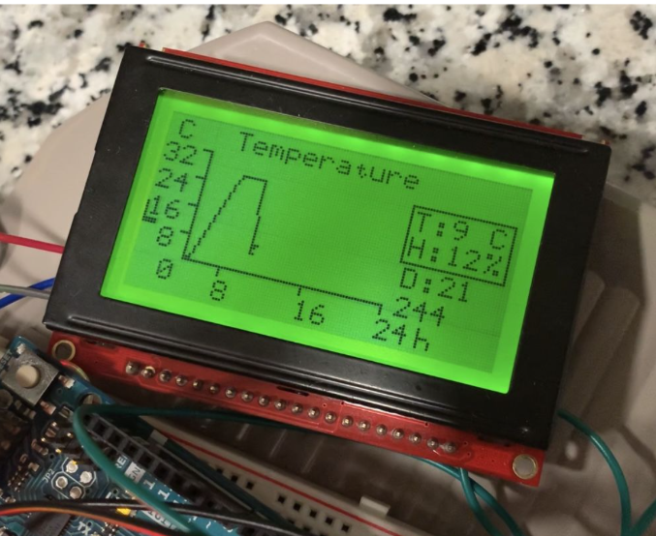
Briefing the ongoing tasks
The objective is to make a graphical representation of the obtained temperature and humidity on an LCD screen being a relation of value x time (24h).
After every 5 iterations (seconds) the screen switches by displaying the temperature and the humidity.
The final result is obtained in the following figure:

Slide 13
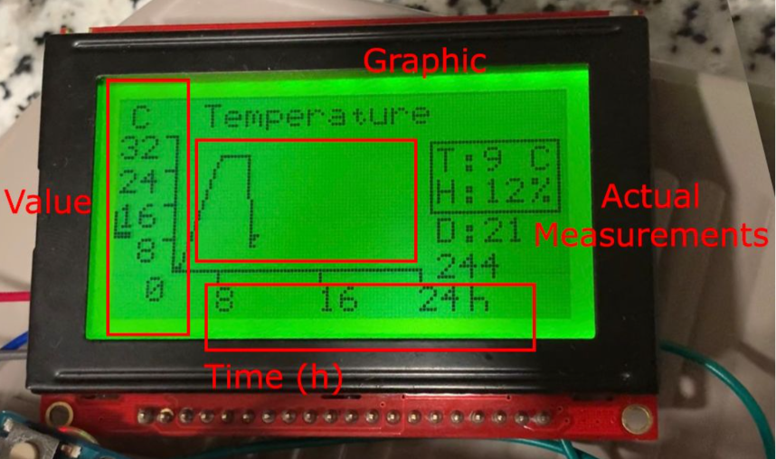
Final Result
All values for the graph are saved on an array of co-ordinates so we see the graphics for 24h
The y-axis represents the temperature in Celsius
The x-axis represents the time in hours

Slide 14
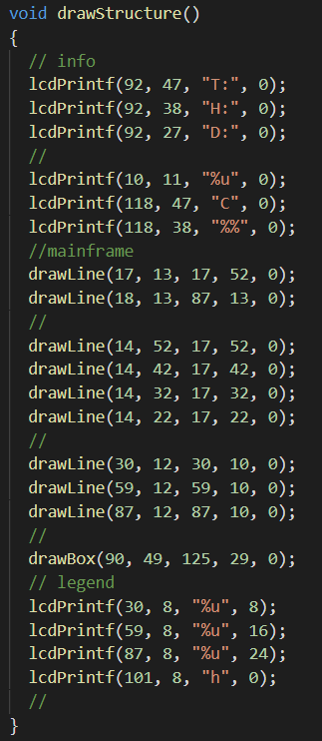
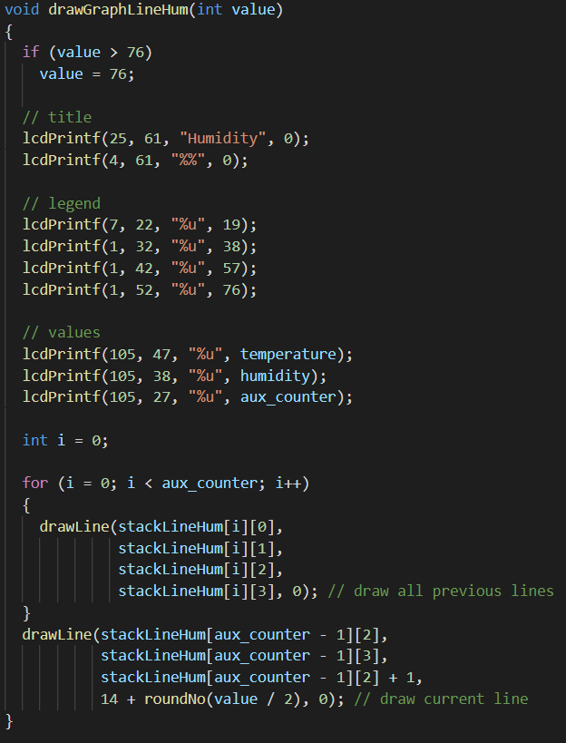
Code part for the temperature and for humidity (entire code is on GitHub):
Drawing
structures
of graphic:
Drawing line:

Slide 15
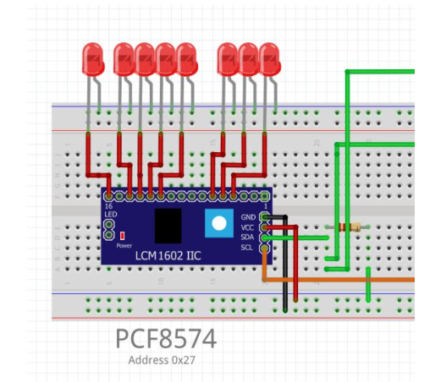
Briefing the ongoing tasks
Danillo / Ronnel
02
Ultrasonic LED bar representation
The PCF is connected to the Raspberrry via the SDA and SCL lines (along with a resistor).
The wiring connection can be seen as shown in the figure:

Slide 16
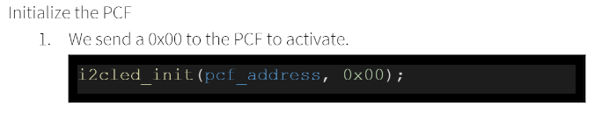
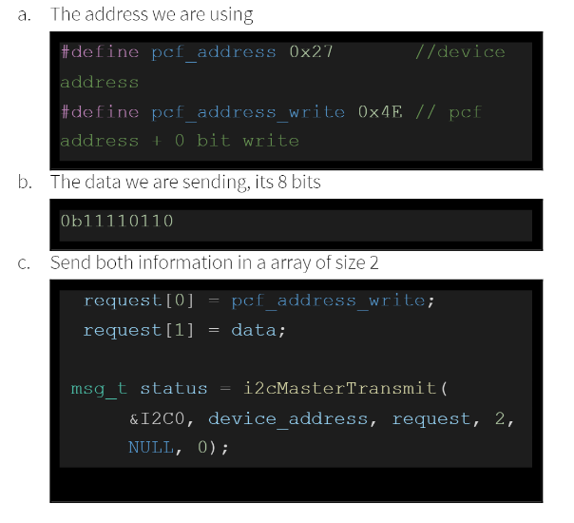
Code (ChibiOS)
Next, we need to send 2 information to the PCF:
The own address + 0 (to indicate it is a write operation)
The data that will inform which pins will light up the LEDs
The whole source code can be seen on GitHub

Slide 17
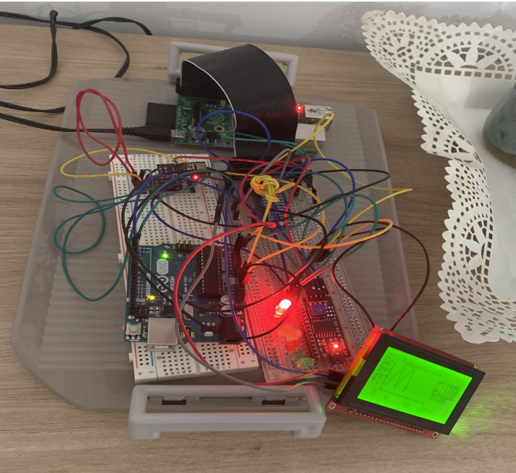
Final Result
The objective was to work with the PCF 8754 to turn on LEDs on an LED bar to represent the level of container and it receives the distance from the sensor and makes the calculation to display the correct amount of LEDs to switch on

Slide 18
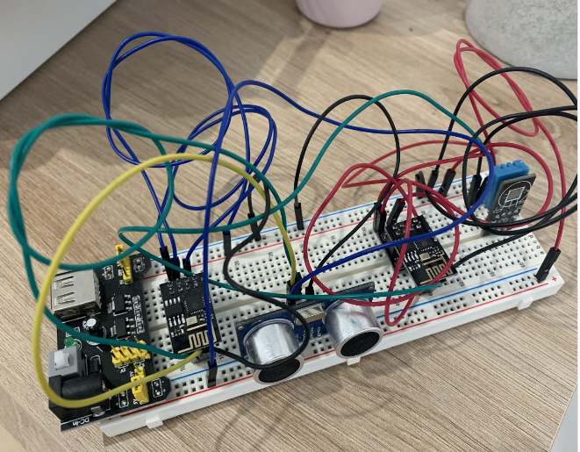
Briefing the ongoing tasks
Danillo Lange
03
Final Assembly
Now, we will move on to the final part of our project which is assembling all the components from the previous sprints and developing the project
Power considerations: The Data Producers 1 and 2 are connected to the shield of power supply

Slide 19
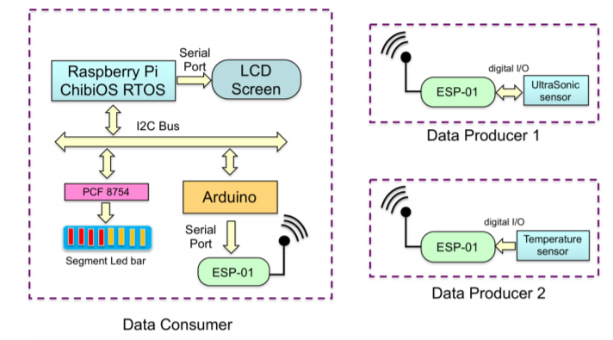
Briefing the ongoing tasks
2. Preparation: We have developed and built the project using the codes in the following GitHub folders:
Data Producers: https://github.com/jy-977/UBQ-/tree/main/code
Arduino (Data Receiver): https://github.com/jy-977/UBQ-/tree/main/code/Receiver_ARDUINO
ChibiOS: https://github.com/jy-977/UBQ-/tree/main/code/ChibiOS_i2c_Raspberry

Slide 20
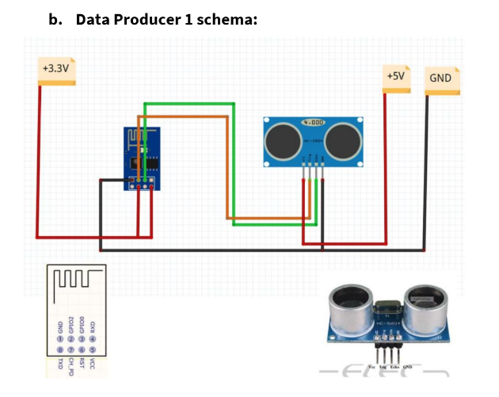
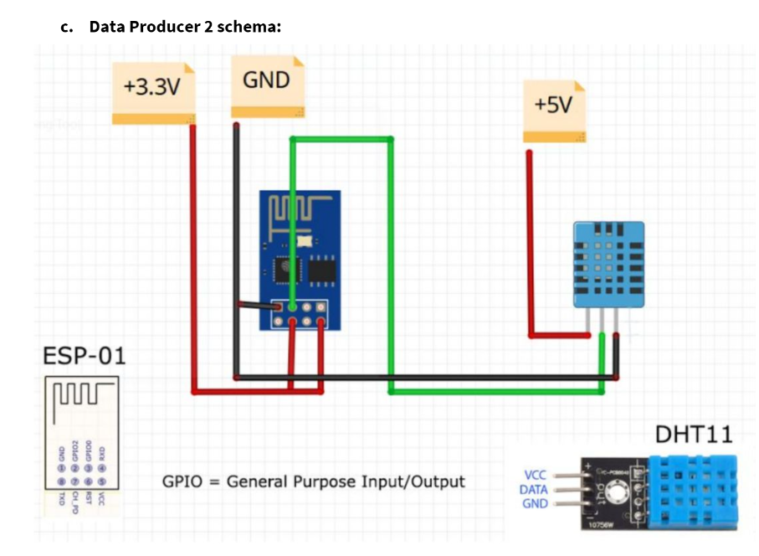
Briefing the ongoing tasks
3. Wiring Connection

Slide 21
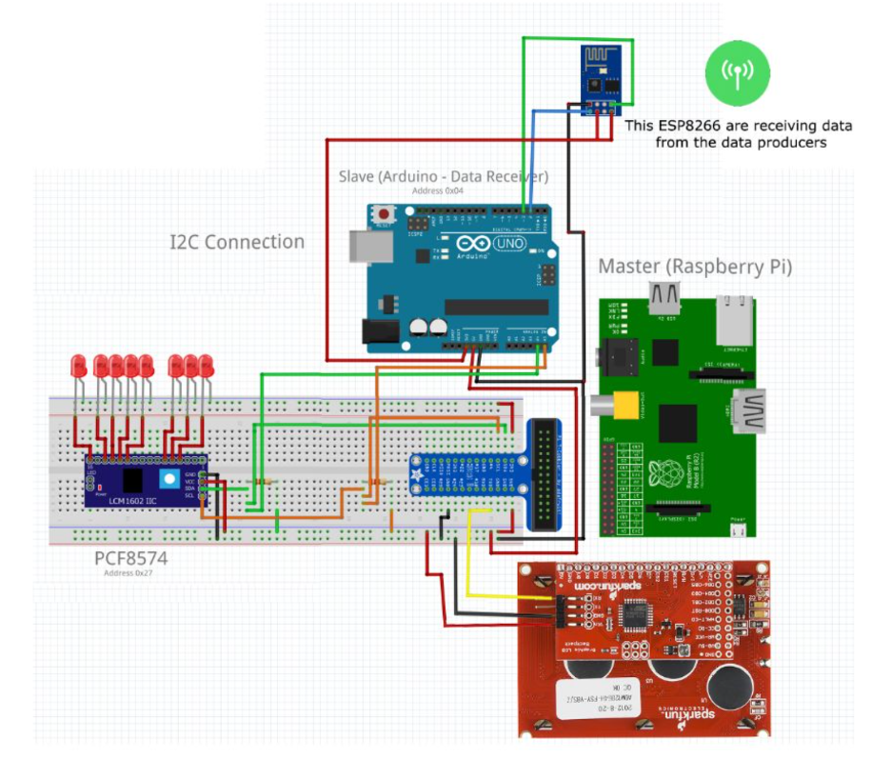
Briefing the ongoing tasks
This is the wiring connection for the Data Receiver schema wherein, the Arduino is the Slave and Raspberry acts as the Master

Slide 22
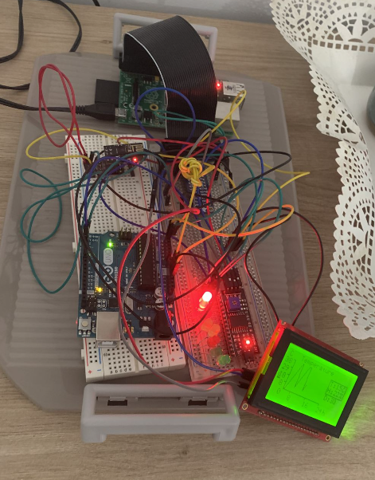
Briefing the ongoing tasks
The built Data Receiver using 2 breadboards:

Slide 23
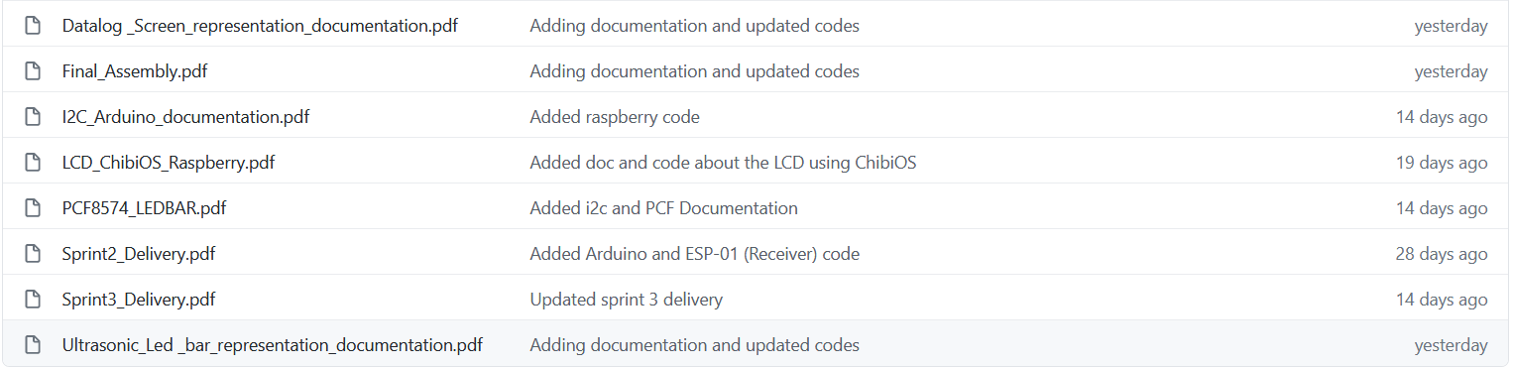
04
CO NEW VISION 2020
4th Sprint
Documentation related to this sprint (Sprint 4) on GitHub
Sprint goal:
The goal of this sprint was to finally implement the last layer of the project which is the
graphical representation to the final users. Design an easy to read screen with information is
also in the priorities, for the LED segment bar we are considering it to reflect the actual state
of measurements made by the distance sensor
Problems faced:
- Difficulties in programming in ChibiOS, sometimes the program would just ignore all the thread sleeps
- Hard to figure it out how to communicate with the PCF8574

Slide 24
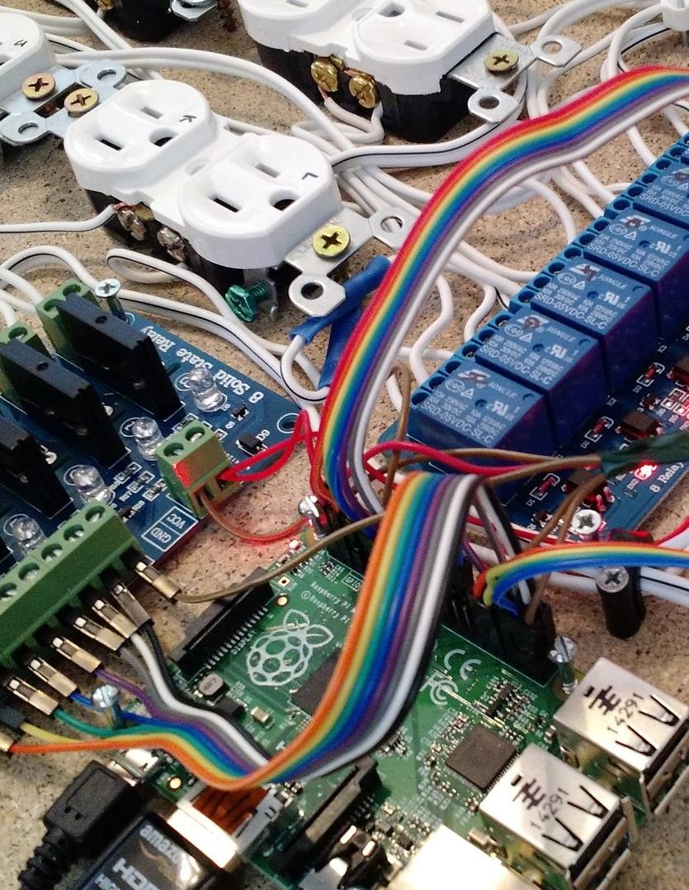
Logo
UDL
MINF 20-21
Q&A
04
Thank you for listening

